Slide 1
VISUVALIZATION REPROT BY USING SQL AND POWER-BI

Slide 2
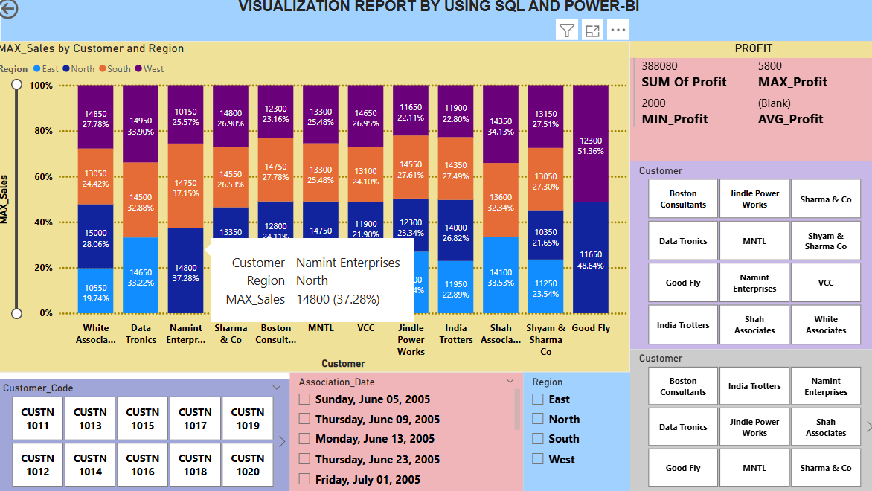
VISUVALIZATION OF SALES AND PROFIT BY REGION AND CUSTOMER

Slide 3
Sales and Profit Analysis Report
Overview:
The dashboard provides a detailed analysis of sales and profit data categorized by customer and region.
2.100% Stacked Column Chart Analysis:
Title: Max of Sales by Customer and Region
Y-axis: Max of Sales (percentage scale from 0% to 100%)
X-axis: Customer (listing various customers such as Data Tronics, Good Fly, India Trotters, etc.)
Regions: East (blue), North (light blue), South (orange), West (purple),
Each bar represents the maximum sales for a customer, segmented by region, with specific sales values labeled.
3. Statistics:
Profit: Sum Profit: 2,275,100, Max Profit: 5,800, Min Profit: 2,000, Avg Profit: 3,856.10
Sales: Sum Sales: 7,405,200, Max Sales: 15,000, Min Sales: 10,000, Avg Sales: 12,551.19
Category by Region: East, North, South, West
Association Date (Year):2005,2006,2007,2008
Customer List : Boston Consultants, Data Tronics , Good Fly, India Trotters , Jindal Power Works, MNTL, Namint Enterprises, Shah Associates, Sharma & Co, Shyam & Sharma Co, VCC, White Associates.

Slide 4
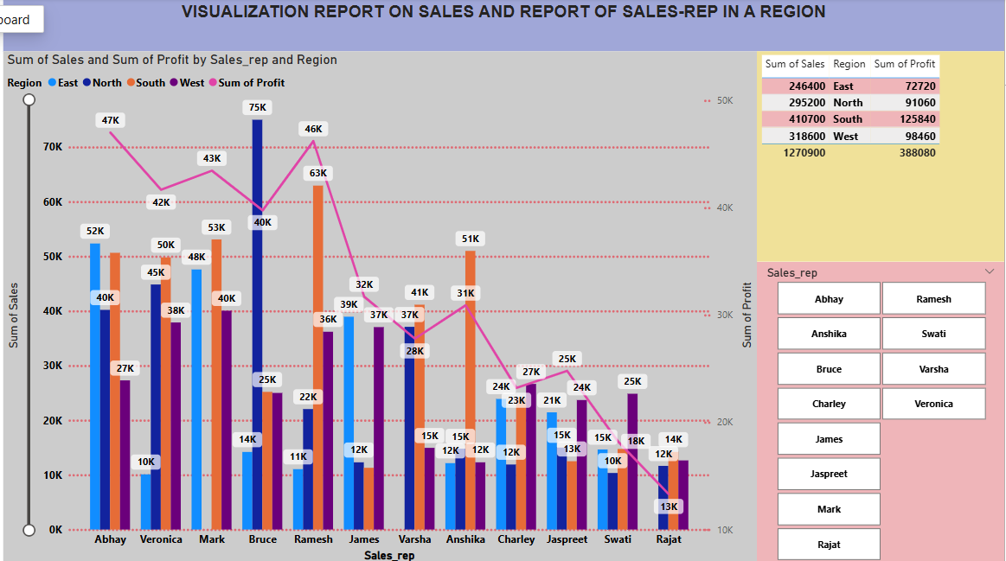
VISUVALIZATION REPROT ON SALES AND PROFIT OF SALES_REP IN A REGION

Slide 5
Overview:
This report provides a summary of sales and profit data for sales representatives in the East region.
Line and clustered column chart Analysis:
Title: Sum of Sales and Profit by Sales Representatives
X-axis: Sales Representatives (e.g., Abhay, Anshika, Bruce, etc.)
Y-axis: Sum of Sales (in thousands, K)
Representation:
Blue bars represent the sum of sales
Blue line represents the sum of profit
Statistics:
Total Sum of Profit: 560,820
Total Sum of Sales: 1,866,200

Slide 6
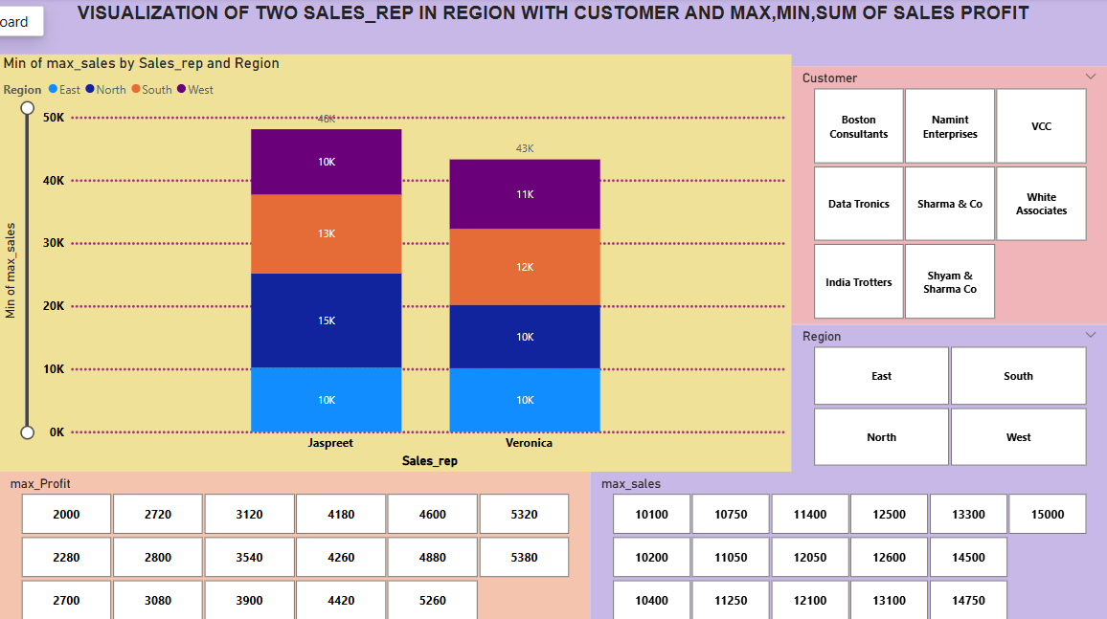
VISUVALISATION OF TWO SALES_REP IN REGION WITH CUSTOMER AND MIN,MAX,AVG,SUM OF SALES AND PROFIT

Slide 7
Sales and Profit Report for two sales represent
This report provides a summary of sales and profit data for the sales representatives jaspreet and Veronica across four
regions: East, North, South, and West.
Sales and Profit Analysis
Title: Max of Min Sales by Sales Rep and Region
X-axis: Sales Representatives (Jaspreet, Veronica)
Y-axis: Max of Min Sales (in thousands, K)
Region Representation:
East (Blue), North (Dark Blue), South (Orange), West (Purple)
Both Abhay and Varsha have equal sales of 15K in each region, represented by color-coded bars for each region.
Customer: Customer List : Boston Consultants, Data Tronics , Good Fly, India Trotters , Jindal Power Works, MNTL, Namint Enterprises, Shah Associates, Sharma & Co, Shyam & Sharma Co, VCC, White Associates.
Sales: Sum of Total Sales: 1,381,350, Average Sales: 12,557.73, Minimum Sales: 10,000, Maximum Sales: 15,000
Profit: Sum of Total Profit: 414,000, Average Profit: 3,763.64, Maximum Profit: 5,760, Minimum Sales: 10,000

Slide 8
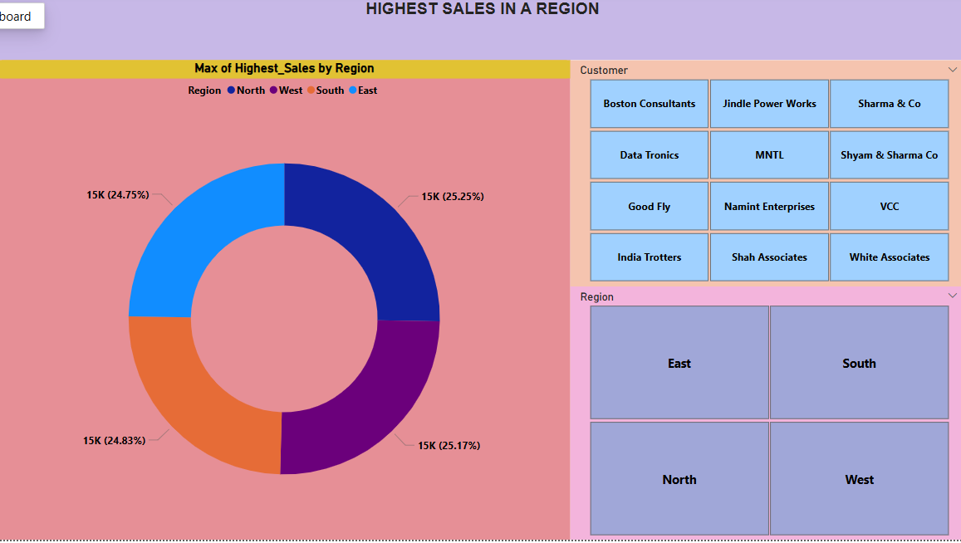
HIGHEST SALES IN A REGION

Slide 9
Highest Sales in a Region – Report:
This report presents the highest sales figures for different regions, along with a list of customers associated with the
regions.
Max Sales by Region: East, North, South, West
Sales Figure: 15K each, representing 25% of total sales for each region
Donut Chart Analysis:
Title: Max of Highest Sales by Region
Regions and Sales (15K each):
East: Light Blue, North: Dark Blue, South: Orange, West: Purple
Customer List : Boston Consultants, Data Tronics , Good Fly, India Trotters , Jindal Power Works, MNTL, Namint
Enterprises, Shah Associates, Sharma & Co, Shyam & Sharma Co, VCC, White Associates.

Slide 10
THANK YOU

